Slide 1
Short Final Rudder Pedals
Assembly, Care and Feeding Manual

Slide 2
Section 1
Frame Assembly

Slide 3
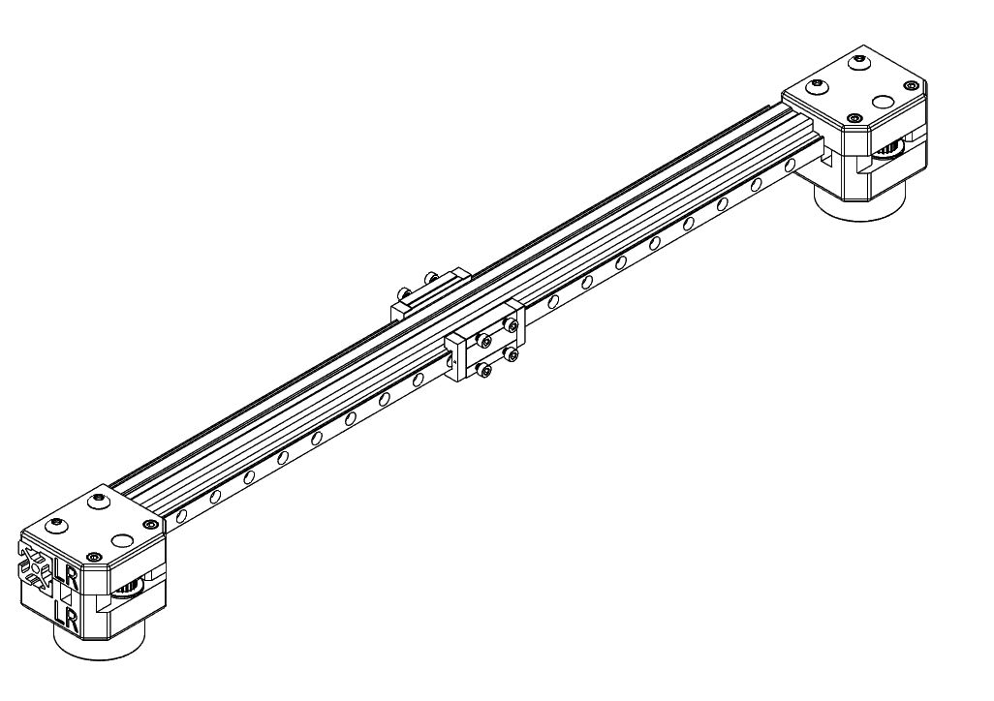
Frame Side Rail Assembly

Slide 4
